Slide 1
Computer Architecture I Group 4D
An Hu
Donai Long
Bo Peng
Jackie Preston

Slide 2
Unique Aspects of the Design
Initially a one-register accumulator
Became an accumulator with stack-like implementation

Slide 3
Unique Aspects of the Design
Processor uses very few registers
Chose hexadecimal for machine language

Slide 4
Changes We’d Like to Make
Add more registers
Better implement the memory
Add interrupts
Make it a pipeline

Slide 5
Challenging Aspects
How to properly implement instructions
Creating our block memory
Not technically challenging just very annoying
Integration Testing
Clock
Admit you all had this same problem

Slide 6
Interesting Aspects
Operations
What makes our processor special… in a good way
Collaborative effort

Slide 7
The (not so) Wonderful World of Xilinx
IOB Devices
Error and warning messages

Slide 8
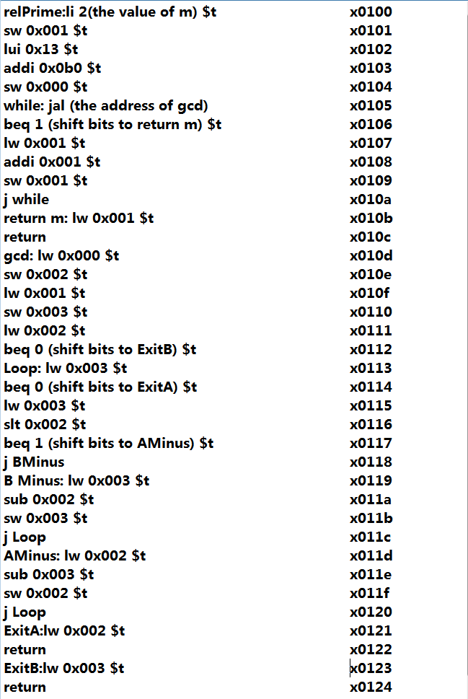
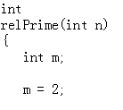
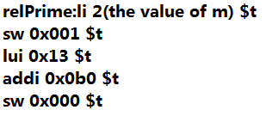
Euclid's Algorithm & relPrime

Slide 9
Euclid's Algorithm & relPrime
112261 Instructions execute in relPrime
367506 cycles involve in relPrime
3.273 cycles/instruction in average
88 Bytes needed to implement the design
74 Bytes = 37 Instructions * 2Bytes/Instruction
8 Bytes = 4 Variables *2Bytes/Variable
4 Bytes = 2 Return Address *2Bytes/Return
2 Bytes = Stack Pointer

Slide 10
Euclid's Algorithm & relPrime
77.472ns
for one single cycle in average
138.988ms
for the whole relPrime to finish
13.518MHz
is the Maximum Frequency

Slide 11
Euclid's Algorithm & relPrime
IOB Devices
Error and warning messages

